Slide 1
CSE473 – Network and Information Security
Penetration Testing / Ethical Hacking
1901042646 Mert Gürşimşir
May 2024

Slide 2
CONTENTS
Introduction
Theoretical Explanation and Related Studies
Popular Studies and Comparisons
Conclusion and Recommendations
References

Slide 3


Slide 4

INTRODUCTION
What is Penetration Testing?
Penetration testing is offensive form of security testing designed to provide a deep technical analysis of a target environment’s vulnerability to exploitation and attack.
Why is it important?
Pentesting helps organizations to identify weaknesses in their systems before attackers can exploit them.
Justification
Penetration testing is justified by its ability to identify and mitigate security vulnerabilities, manage risks efficiently and improve overall security of an organization.

Slide 5

THEORETICAL EXPLANATION AND OTHER STUDIES
Penetration testing, often abbreviated as pentest, is a process that is followed to conduct an in-depth security assessment or audit. A methodology defines a set of rules, practices, and procedures that are pursued and implemented during the course of any information security audit program.
Methodology steps:
• Reconnaissance
• Scanning
• Testing
• Exploitation

Slide 6

THEORETICAL EXPLANATION AND OTHER STUDIES
STUDIES
Automated Source Code Scanning
Comprehensive static application security testing (SAST) tools that scan source code for vulnerabilities during the development process.
Advanced Web Application Testing Tools
Key developments in the past 10 years include the introduction of Burp Suite Professional and Enterprise editions, enhanced scanning capabilities, and the addition of machine learning algorithms to improve vulnerability detection.

Slide 7

THEORETICAL EXPLANATION AND OTHER STUDIES
Container and Cloud Security
In the last 10 years, some innovations have been done in this area. One of them is Falco by Sysdig. It is a project that focuses on runtime security for containers and cloud environments. It uses rule-based detection to monitor and alert on suspicious activity.
Enhanced Network Security Tools
Detection of network vulnerabilities is used to determine weaknesses of the network, the risk evaluation of attacks, the diagnosis and suggestions to solve the problems.

Slide 8
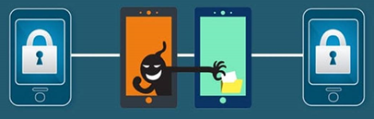
THEORETICAL EXPLANATION AND OTHER STUDIES
Mobile Application Security
This area has gained importance recently in order to ensure rapid security in the field of mobile applications and to prevent possible losses by eliminating vulnerabilities. MobSF (2015) which is mobile security framework is an open-source automated security testing framework for mobile applications.
IoT and Embedded Systems Security
Several studies have been conducted in this area. For the result of these studies, a tool is generated: Binwalk is a tool for searching a given binary image for embedded files and executable code. Specifically, it is designed for identifying files and code embedded inside of firmware images.

Slide 9
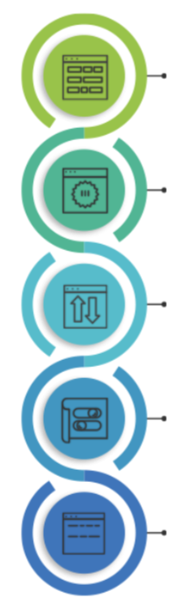
POPULAR STUDIES
The most popular studies are the ones that integrate DevOps methodologies with the cyber security or integrate artificial intelligence with the cyber security. Here is the 4 most popular studies in the examined articles:
• Automated Source Code Scanning
• Advanced Web Application Testing Tools
• Enhanced Network Security Tools
• Mobile Application Security

Slide 10
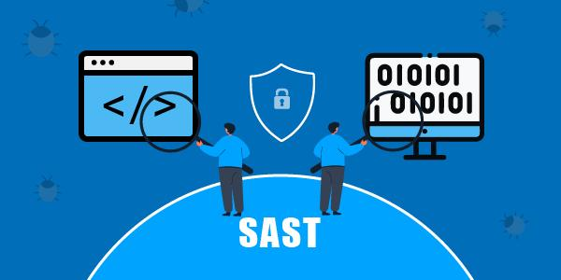
AUTOMATED SOURCE CODE SCANNING
Static Application Security Testing (SAST) tools purport to assist developers in detecting security issues in source code. These tools typically use rule-based approaches to scan source code for security vulnerabilities.
These tools are ideal for early development security with high privacy and integration with DevOps. They scan the source code to detect security vulnerabilities.

Slide 11
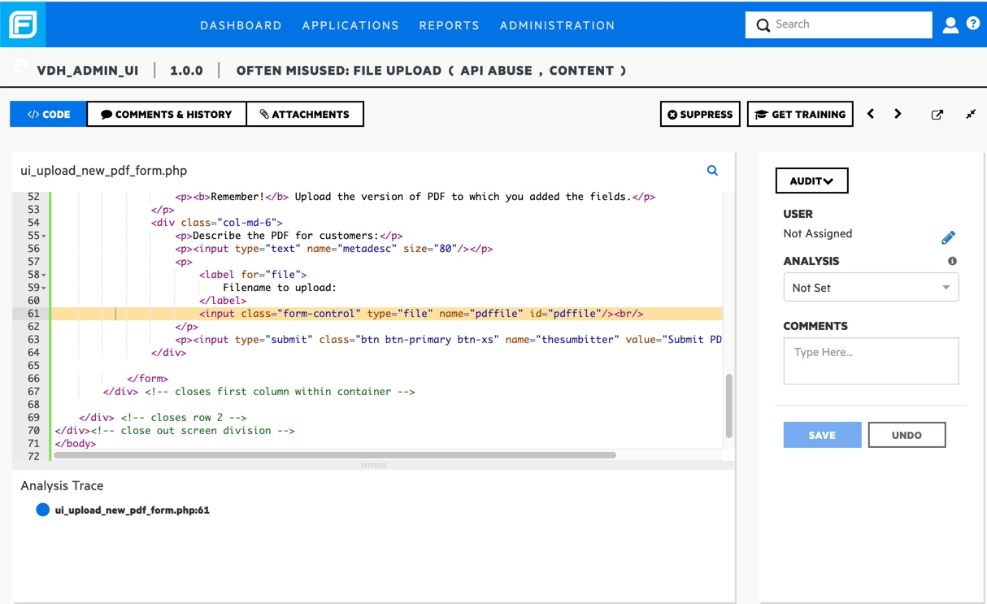
AUTOMATED SOURCE CODE SCANNING

Slide 12

ADVANCED WEB APPLICATION TESTING TOOLS
To make penetration tests easily practicable, people in cyber security field are studying new tools. The most popular and mostly used one is the Burp Suite. Security testing has become a vital part of software development in recent times. It helps us to identify vulnerabilities and loopholes in the software system and in turn fix the errors.
With developing technology, time is very crucial. Therefore security tests should be done faster. Thanks to studies, penetration tests are being more efficient as well as being faster. Automated testing provides this approach.

Slide 13
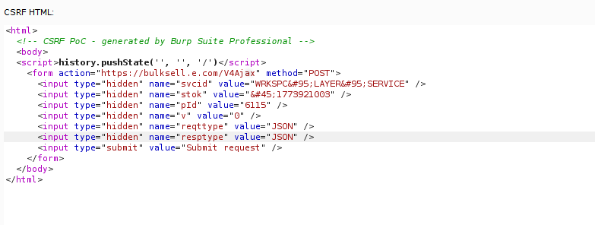
ADVANCED WEB APPLICATION TESTING TOOLS

Slide 14

ENHANCED NETWORK SECURITY TOOLS
There are methodology steps for the penetration testing. For each of these steps, tools are created with the help of studies in these topics. These tools are designed to scan, identify, and mitigate vulnerabilities in networked systems.
Example tools that are studied in this field:
Nmap
SQLMap
Gobuster
Nessus

Slide 15
MOBILE APPLICATION SECURITY
Mobile application security is very important in cybersecurity with the so much use of mobile devices and the sensitive data they handle. Penetration testing in this domain involves a thorough examination of mobile apps to identify and mitigate vulnerabilities that could be exploited by malicious actors. This process consists of both static and dynamic analysis.
Studies conducted that doing both static and dynamic analysis increase the efficiency of penetration testing when we compare the speed and reliability of the results. Static analysis involves examining the mobile application's source code, binaries, or bytecode without executing the application. Dynamic analysis, on the other hand, involves executing the mobile application in a controlled environment to monitor its behavior in real-time.
MobSF is being used actively in the sector as a result of the studies conducted in penetration testing field. Tools like Mobile Security Framework (MobSF) play a significant role in mobile application penetration testing.

Slide 16
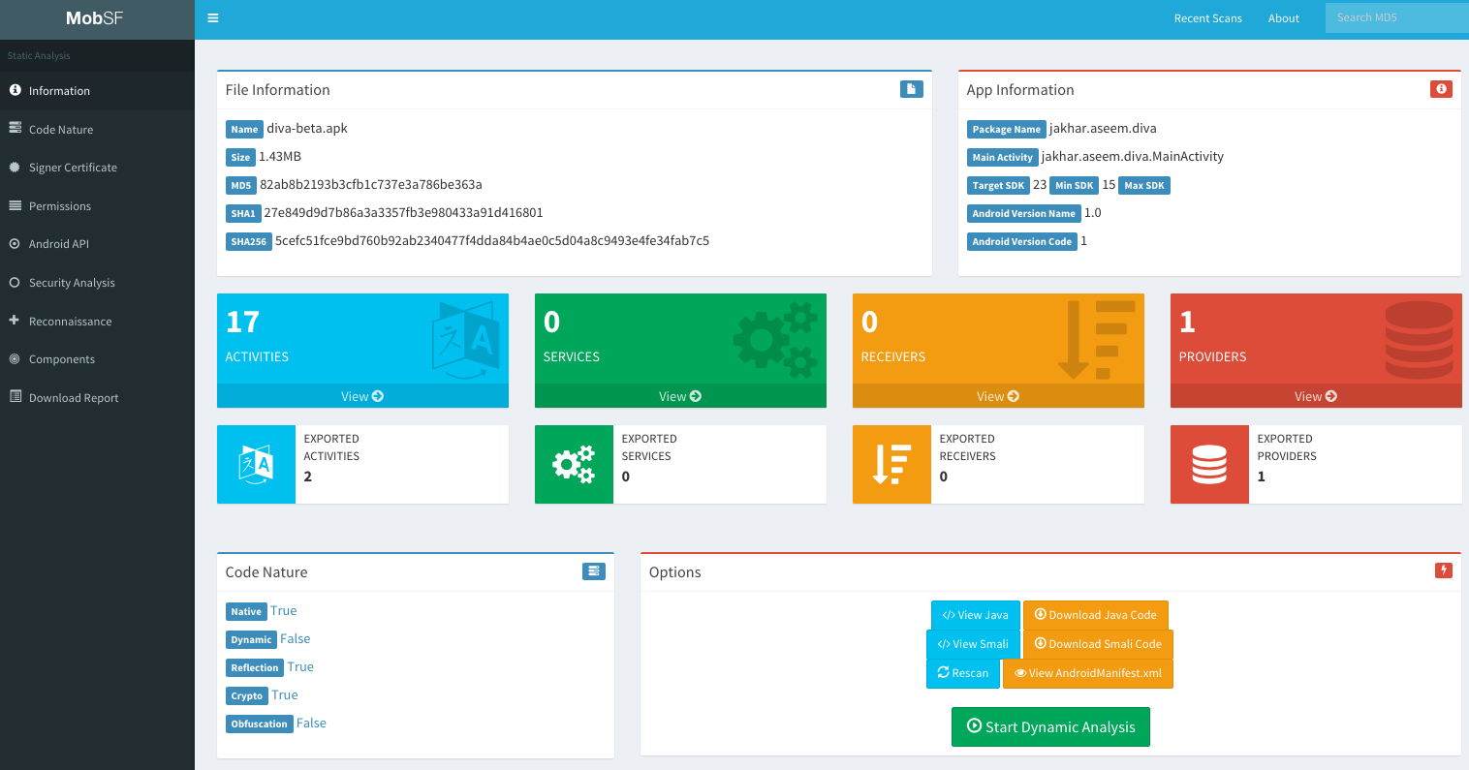
MOBILE APPLICATION SECURITY

Slide 17
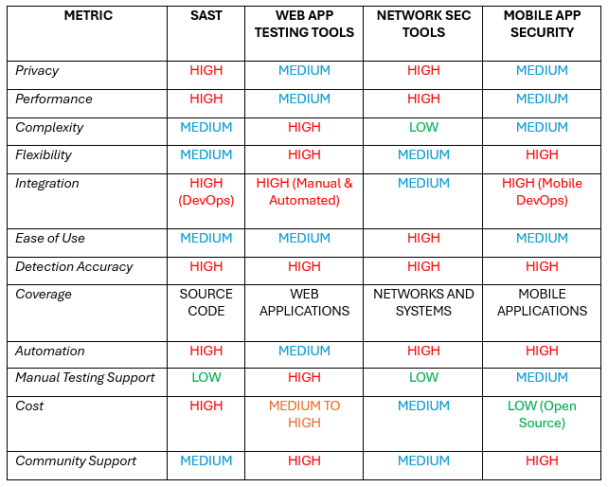
COMPARISONS
Notes:
As you can see, each studied field offers distinct advantages and is suited for different security needs:
SAST: Ideal for early development security with high privacy and integration with DevOps.
Web Application Testing Tools: Excels in flexible and comprehensive web application testing with strong community support.
Network Security Tools: Perfect for network security with ease of use and high performance.
Mobile Application Security: Provides thorough mobile application security with strong community backing and flexibility.

Slide 18

CONCLUSION AND SUGGESTIONS
The studies that are read shows that advancements in technology and the increasing complexity of cyber threats in the world have necessitated the enhancement of penetration testing and ethical hacking tools. In the modern world, tools like Fortify, Burp Suite, Nessus, and MobSF play crucial roles in ensuring strong cybersecurity across various platforms.
As technology continues to develop, integrating security into every stage of the development lifecycle becomes more important day by day.
Studies show that tools such as nmap, mobsf, sqlmap, fortify, burp suite do a very good job in their fields. However, each of them is an advanced tool for micro tasks.

Slide 19
REFERENCES
[1] “M Safe Computing.” University of Michigan Ross School of Business, 13 May 2024, safecomputing.umich.edu/.
[2] “Web App Development: A Detailed Guide.” JayDevs, 25 Sept. 2023, jaydevs.com/web-app-development-a-detailed-guide/.
[3] “Ethical Hacking Research Paper Example | Topics and Well Written Essays - 1250 words”, n.d.
[4] “Kali Linux - Assuring Security by Penetration Testing” Lee Allen, Tedi Heriyanto, Shakeel Ali. April 2014.
[5] Yang, Jinqiu, et al. "Towards better utilizing static application security testing." 2019 IEEE/ACM 41st International Conference on Software Engineering: Software Engineering in Practice (ICSE-SEIP). IEEE, 2019.
[6] Myrbakken, H., & Colomo-Palacios, R. (2017). DevSecOps: a multivocal literature review. In Software Process Improvement and Capability Determination: 17th International Conference, SPICE 2017, Palma de Mallorca, Spain, October 4–5, 2017, Proceedings (pp. 17-29). Springer International Publishing.
[7] Tomás de J. Mateo Sanguino, "Enhancing Security in Industrial Application Development: Case Study on Self-Generating Artificial Intelligence Tools", Applied Sciences, vol.14, no.9, pp.3780, 2024.

Slide 20
REFERENCES
[8] R. Bouafia, H. Benbrahim and A. Amine, "Automatic Protection of Web Applications Against SQL Injections: An Approach Based On Acunetix, Burp Suite and SQLMAP," 2023 9th International Conference on Optimization and Applications (ICOA), AbuDhabi, United Arab Emirates, 2023, pp. 1-6, doi: 10.1109/ICOA58279.2023.10308827.
[9] D. Mubanda, N. Mandela, T. Mbinda and C. Ayesiga, "Evaluating Docker Container Security through Penetration Testing: A Smart Computer Security," 2023 International Conference on Communication, Security and Artificial Intelligence (ICCSAI), Greater Noida, India, 2023, pp. 415-419, doi: 10.1109/ICCSAI59793.2023.10421124.
[10] KUSHE, R. Comparative study of vulnerability scanning tools: Nessus vs Retina. Security & Future, 2017, 1.2: 69-71.
[11] “How Many Apps Are There in the World.” BankMyCell, 8 Apr. 2024, www.bankmycell.com/blog/number-of-mobile-apps-worldwide.
[12] S. Lee and E. -S. Cho, "Toward Firmware-Type Analysis Using Machine Learning Techniques," 2018 IEEE 42nd Annual Computer Software and Applications Conference (COMPSAC), Tokyo, Japan, 2018, pp. 977-978, doi: 10.1109/COMPSAC.2018.00172.
[13] A. Kore, T. Hinduja, A. Sawant, S. Indorkar, S. Wagh and S. Rankhambe, "Burp Suite Extension for Script based Attacks for Web Applications," 2022 6th International Conference on Electronics, Communication and Aerospace Technology, Coimbatore, India, 2022, pp. 651-657, doi: 10.1109/ICECA55336.2022.10009116.
[14] Creating a CSRF POC using Burp Pro?. Enciphers Labs Pvt Ltd. (n.d.). https://www.enciphers.com/web-app-security/creating-a-csrf-poc-using-burp-pro

Slide 21
REFERENCES
[15] Vavkamil. (n.d.). Vavkamil/awesome-bugbounty-tools: A curated list of various bug bounty tools. GitHub. https://github.com/vavkamil/awesome-bugbounty-tools?tab=readme-ov-file
[16] How to read A nessus report - uva its. (n.d.). https://virginia.service-now.com/its?id=itsweb_kb_article&sys_id=75e70054dbb553404f32fb671d9619d5
[17] ALANDA, Aide, et al. Mobile application security penetration testing based on OWASP. In: IOP Conference Series: Materials Science and Engineering. IOP Publishing, 2020. p. 012036.

Slide 22
Thanks for listening!

